Slide 1

BestReadsUK
E-MARKETING
STRATEGY
TEAM-9
NAVYASRI TANGUTURI
MURAD MIRZAKHANLI
FONGEI LANGMIA LEBKUNA BERYL
KRISHNA KUMAR
DESH RAJ
JENNIFER NGUM
20
24

Slide 2
WEBSITE DEVELOPMENT STRATEGIES FOR BESTREADSUK(1)
USER-FRIENDLY DESIGN
RESPONSIVE DESIGN
FAST LOAD TIMES
Intuitive design
Logical flow
Clear navigation
Best reads Logo
Meta description
Clear buttons & icons
Clear menu bar
High quality images
Be Minimalistic
Essential Elements
Concise book descriptions
Website responsiveness
Compress Images
Minimize HTTP Requests
Visual appearance
Consistent Color Scheme
Strategic Dark Colors
Mobile First approach
Fluid Grid system
Adaptive Images
Technologies Used
HTML5 and CSS
JavaScript
Frameworks(Bootstrap, Foundation)
Cross-device testing tools
Code optimization
Optimize rendering processes
Efficient Hosting
File and Media Optimization
Reduce Unnecessary HTTP Requests
Plugin Management
Content Delivery Network (CDN)
Employ a cloud-based monitoring tool

Slide 3
WEBSITE DEVELOPMENT STRATEGIES FOR BESTREADSUK(2)
CALL-TO-ACTIONS (CTAS)
ANALYTICS INTEGRATION
TRUST
AND SECURITY
Strategic placement
Home page-”Shop Now”, browse best sellers
Book details-”Add to cart”, “Add to wishlist”
Checkout process: “Proceed to checkout”,”Go to Wishlist”
Throughout navigation: “Shop now”,”best sellers”.”Best offers”
Sidebars and Banners: “Buy 2, get 1 sale”, “50% discount”, “Get 25% discount on every purchase”
Footer: Social media accounts, Customer support
Visual appeal:
Use contrast or dark colours
Clear goals and KPIs-Increase in book sales, enhancing user engagement, identify KPIs.
Conduct comprehensive website audit
Integrate Google Analytics
Set up Google Analytics
Obtain tracking code snippets
Paste the snippet before the closing </head> tag on every page
Save and publish changes
Monitor data flow into your Google Analytics account
Continuous Monitoring and Optimization
Use analytics insights to improve the website
Generate regular reports to track progress
HTTPS Implementation
Trust Badges
Secure Checkout Process
SSL/TLS Certificate Renewal
Regular Security Audits
Customer Education
Customer Support for Security Concerns

Slide 4
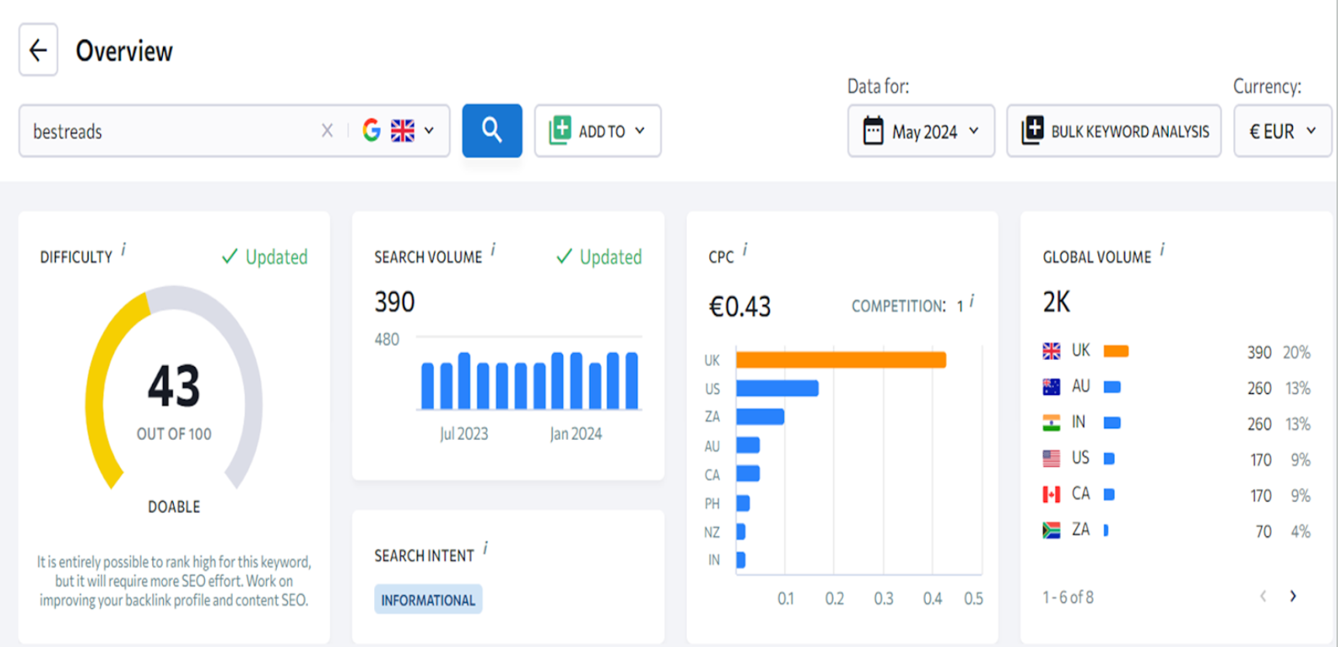
SEARCH ENGINE OPTIMIZATION (SEO) STRATEGY FOR “BESTREADS”

Slide 5
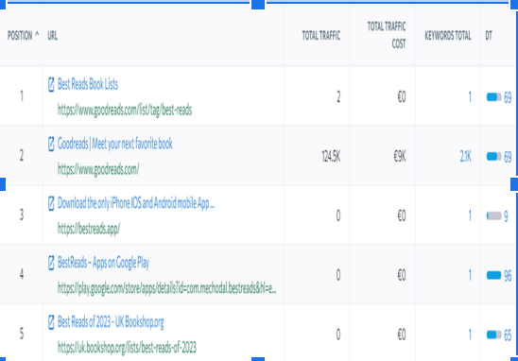
KEYWORDS REFERENCE
TO BRAND NAME
Organic Results
Keyword | Difficulty | Search vol. | Search intent | SERP features | CPC | Competition
best reads | 43 | 390 | I | Featured Snippets, Reviews, Video | 0,43 | 1
what are the best books to read | 43 | 110 | I | Video, People also ask | 0,27 | 0,99
what is the best book to read | 41 | 110 | C | Featured Snippets, Reviews, Video, People also ask, Shopping Results | 0,27 | 0,99
what is the best books to read | 42 | 110 | I | Video, People also ask, Images | 0,27 | 0,99

Slide 6

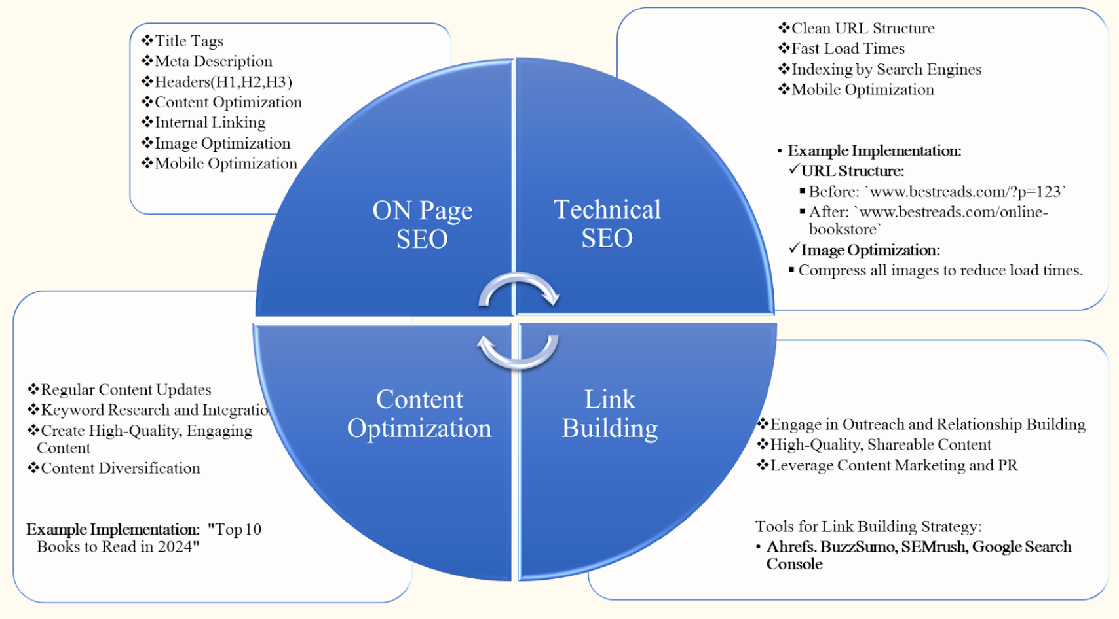

Slide 7
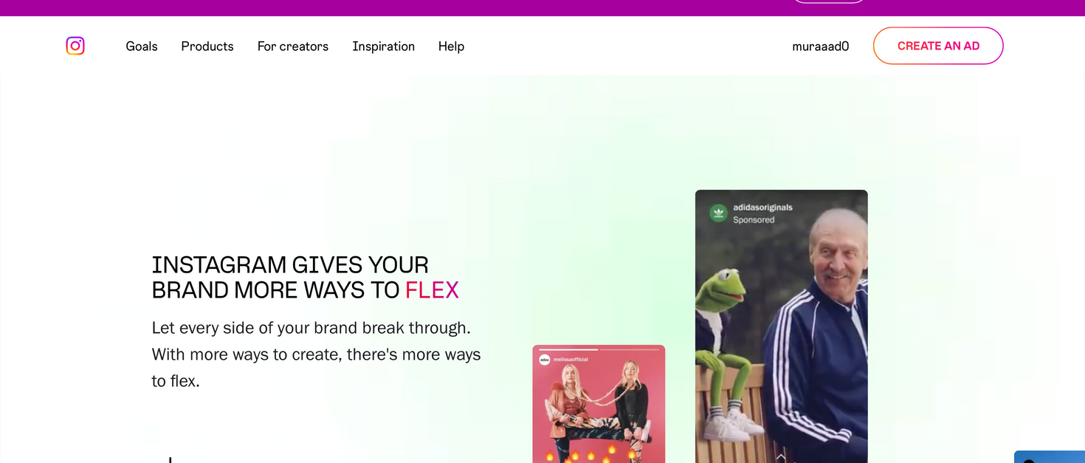
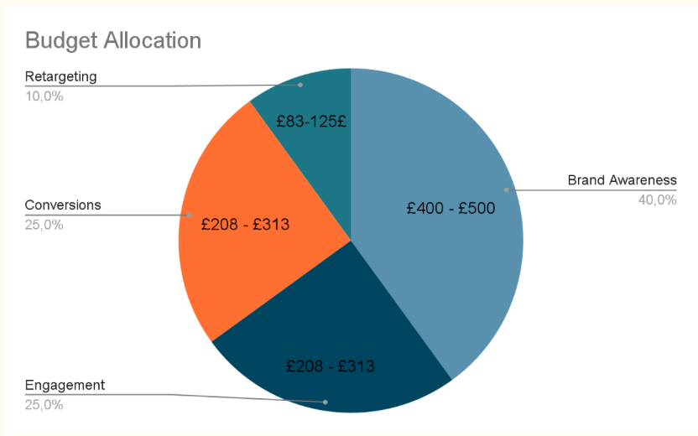
INSTAGRAM ADS BUDGET ALLOCATION FOR BESTREADSUK
OVERALL BUDGET
Annual Budget: £10,000 - £15,000
Monthly Budget: £833 - £1,250
Campaign Goal | Ad Formats
Brand Awareness | Photo ads, video ads, stories ads
Conversions | Shopping ads, photo ads
Engagement | Carousel ads, interactive stories ads
Retargeting | Dynamic ads, stories ads

Slide 8


AD CREATION
📖 Discover Your Next Adventure at BestReadsUK! 📖
Ready to embark on a literary journey? Step into our world of books and uncover captivating stories waiting just for you. Whether you crave thrilling suspense, heartwarming romance, or thought-provoking classics, we have the perfect read to ignite your imagination.
🎉 Exclusive Offer: Get 15% off your first order! 🎉
Start your reading adventure today. Click the link below to explore our collection!

Slide 9
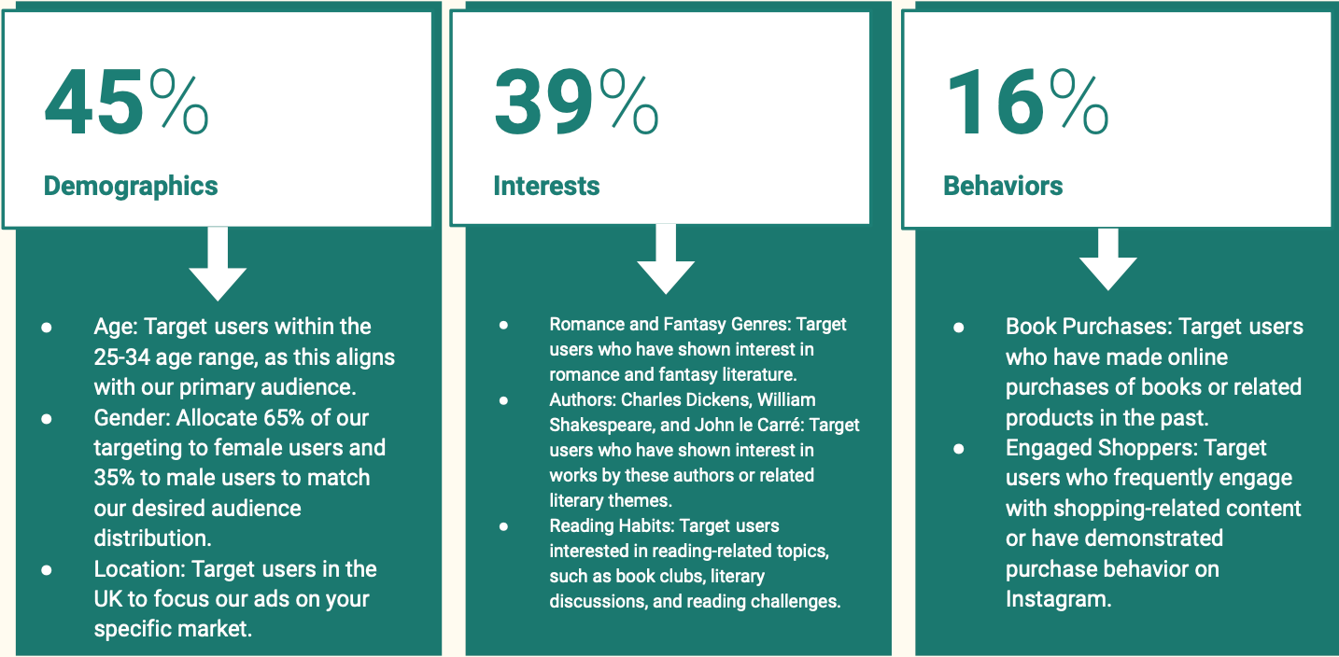
TARGETINGS

Slide 10
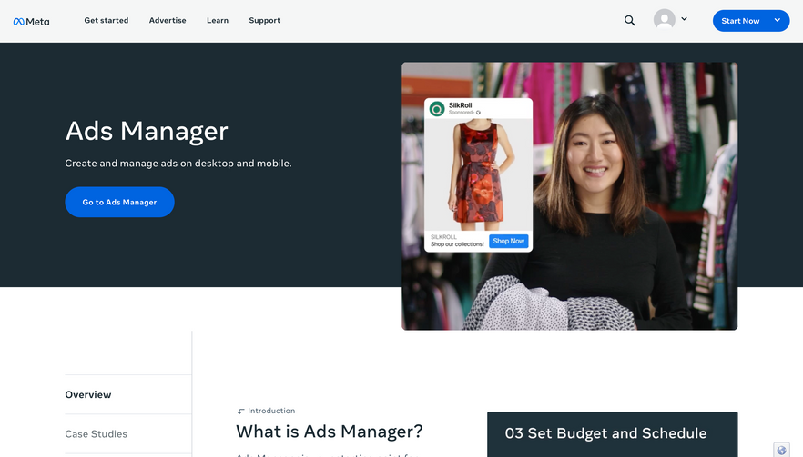
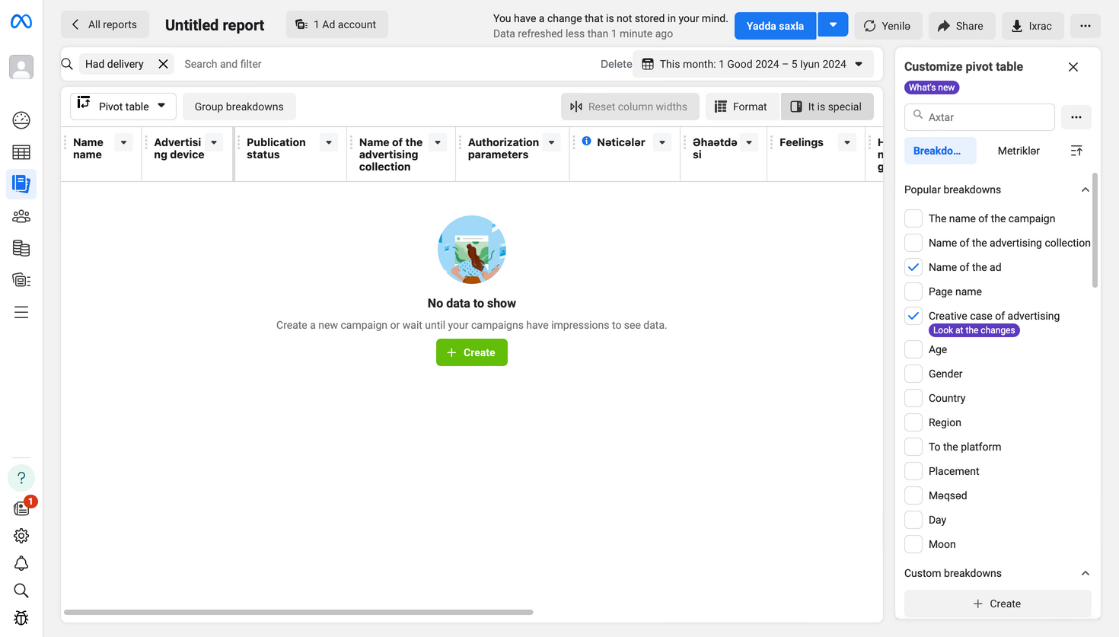
TRACKING AND ANALYTICS:
Set Up Conversion Tracking:
Instagram Ads: Use Facebook’s Ad Manager for Instagram ad tracking.
Analyze Performance:
Regularly review performance reports from Google Analytics, Facebook Ad Manager, and other tools.
Track key metrics: clicks, impressions, conversions, cost per acquisition (CPA), return on ad spend (ROAS)
MORE INFORMATION
20
22

Slide 11
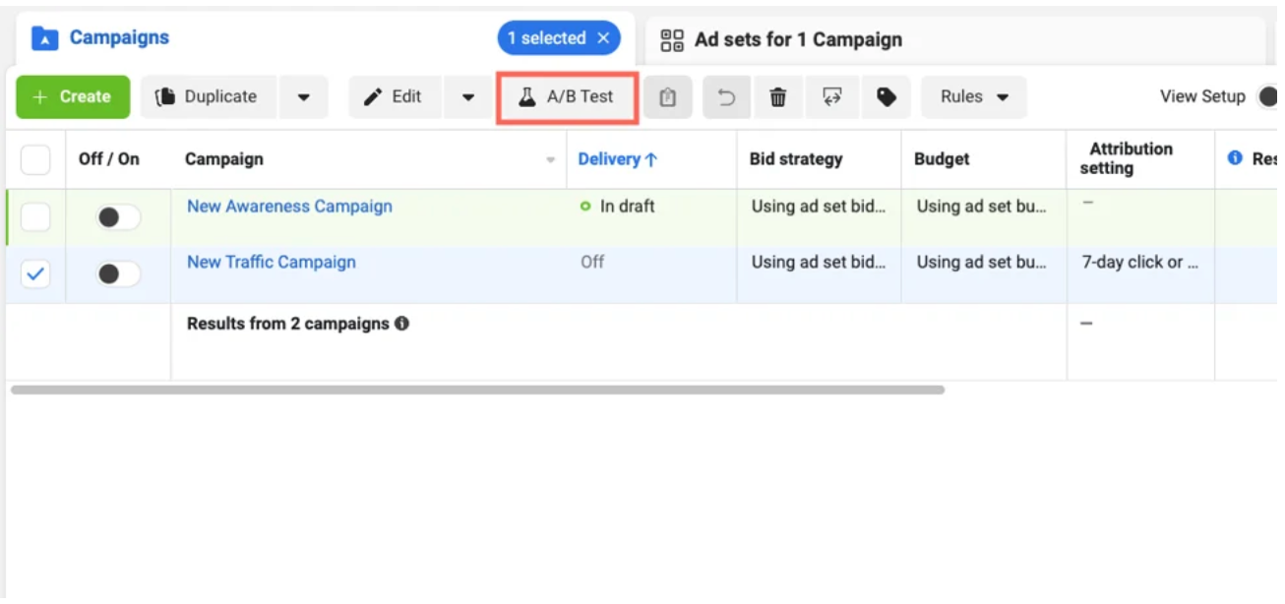
A/B Testing:
Goal: Increase book purchases on Instagram.
1. Define Goal:
- Increase conversions (book purchases).
2. Choose What to Test:
- Headlines, Images, Ad Copy, CTA, Audience.
3. Create Two Ad Versions:
- Ad A: "Discover the Best Reads at BestReadsUK!"
- Ad B: "Unlock Exclusive Discounts on Top Books Today!"
4. Set Up Test:
- Use Facebook Ads Manager.
- Split budget equally (e.g., £250 each).
5. Run Test for 7-14 Days.
6. Analyze Results:
- Compare CTR, Conversion Rate, CPC.
- Example: Ad A (CTR 1.5%, Conversion 2%), Ad B (CTR 2.0%, Conversion 3.5%).
7. Implement Winner:
- Use the better-performing ad.
8. Repeat Monthly:
- Continuously test new variations.

Slide 12


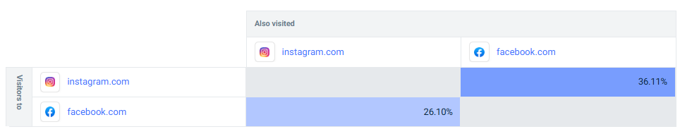
Social Media Marketing - Platform
We have chosen Facebook and Instagram as our primary and secondary platforms.
Facebook allows us to connect with a vast audience and target ideal customers (book lovers).
Instagram's visual focus is perfect for showcasing book covers and creating a lifestyle around reading.

Slide 13
Content Calendar
Day of the week | Hashtags | Content | Post type
Monday | #Monday #NewReals #Booklovers | Striking image of a newly released book. | Image
Tuesday | #Tuesday #Authors #Comment | Short video clip featuring an in-store author event. Author commenting on their book and what inspired them to write it. | Text
Thursday | #Behindthescene #Book #Booknerd #Thursday #Throwbackthursday | Participate in a trending book-related challenge. Fun facts challenge. Review of last week’s progress and discussion. Users experience Influencer’s opinion and recommendations. | Short Videos
Friday | #Friday #Motivation | Eye-catching image showcasing a book with / without a famous character to explicitly emphasize on the comfort and anxiety surround bookworms haven at BestReadsUK. | Image
Saturday | #Saturday #booklovers #inspiration | Share customer reviews and recommendations Have a Q&A session Discussions Share inspirational book quotes Get the chance to get a fee edition of the book or a one-to-one discussion with the author via active participation View user-generated contents. | Live Video

Slide 14

Implementation
Marketing Engagement
Influencer partnership
Analysis
Technology requirement

Slide 15
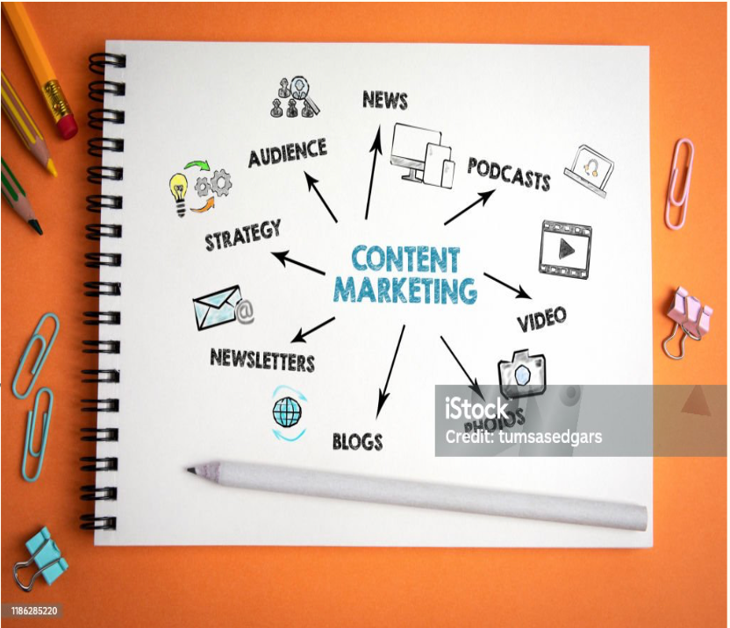
CONTENT MARKETING
With an emphasis on providing value to a clearly defined target group, BestReadsUK's content marketing seeks to increase brand awareness, boost traffic, and generate leads. As part of the plan, a variety of content types are created and disseminated via various channels, including as social media, email, and the company website, in accordance with the preferences of the target audience. Engagement rates, conversion metrics, and ROI are used to measure success and make sure it aligns with overall corporate objectives. BestReadsUK has seen a rise in revenue, client loyalty, and visibility as a result of its strategy.

Slide 16
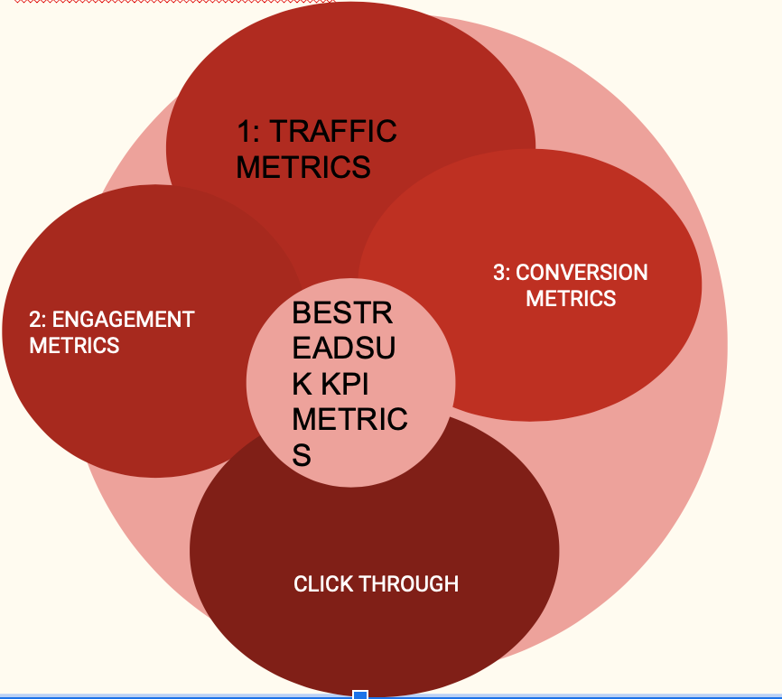
KEY METRICS AND TRENDS FOR BESTREADSUK
03
The content marketing strategy employed by BestreadsUK has produced noteworthy outcomes. There has been a steady growth in website traffic, with unique visitors rising noticeably month over month. Longer session times and less bounce rates show that engagement rates have increased. There has been a noticeable increase in material downloads and email sign-ups, along with strong lead generation. Positive shifts in conversion rates also suggest that more visitors are completing the intended tasks. Above all, there has been a noticeable correlation between the amount spent on content marketing and increased sales, making the return on investment (ROI) quite high. All of these metrics show how successful BestreadsUK's content marketing campaigns are.
20
22

Slide 17

EMAIL MARKETING
Objective:
To increase website traffic, enhance user engagement, and drive book sales across
various genres by leveraging a targeted and segmented email marketing strategy.
Target Audience Analysis:
Primary Audience:
Age Range: 18-60
Demographics: Young adults, middle-aged professionals, and parents
Interests: Thrillers, romance, young adult fiction, non-fiction, classics
Secondary Audience:
Age Range: 0-17 (via parents), 60+
Demographics: Parents looking for children’s books, seniors
Interests: Children’s literature, timeless classics

Slide 18

CAMPAIGN COMPONENTS:
Segmentation Strategy
Content Personalization
Email Types
Design and Layout
Call-to-Actions (CTAs)
Automation
Analytics and Optimization

Slide 19
Sample Email Templates:
Welcome Email:
Subject Line: Welcome to BestReadsUK! Your Next Great Read Awaits
Body
Dear [First Name],
Welcome to BestReadsUK! We’re thrilled to have you join our community of book lovers. Whether you’re into gripping thrillers, heartwarming romances, or insightful non-fiction, we’ve got something special just for you.
As a thank you for joining us, here’s a 10% discount on your first purchase. Use code WELCOME10 at checkout.
Happy Reading,
The BestReadsUK Team
+123-456-7890

Slide 20

THANK YOU
WWW.BESTREADSUK.COM

